Slide 1
Chapter 3 Organic Compounds: Alkanes and Their Stereochemistry

Slide 2
Learning Objectives
(3.1)
Functional groups
(3.2)
Alkanes and alkane isomers
(3.3)
Alkyl groups
(3.4)
Naming alkanes
(3.5)
Properties of alkanes

Slide 3
Learning Objectives
(3.6)
Conformations of ethane
(3.7)
Conformations of other alkanes

Slide 4
Functional Groups
Collection of atoms at a site that have a characteristic behavior in all molecules where they occur
Group reacts in a typical way, generally independent of the rest of the molecule
Example
Double bonds in simple and complex alkenes react with bromine in the same way
Notes:
Functional groups

Slide 5
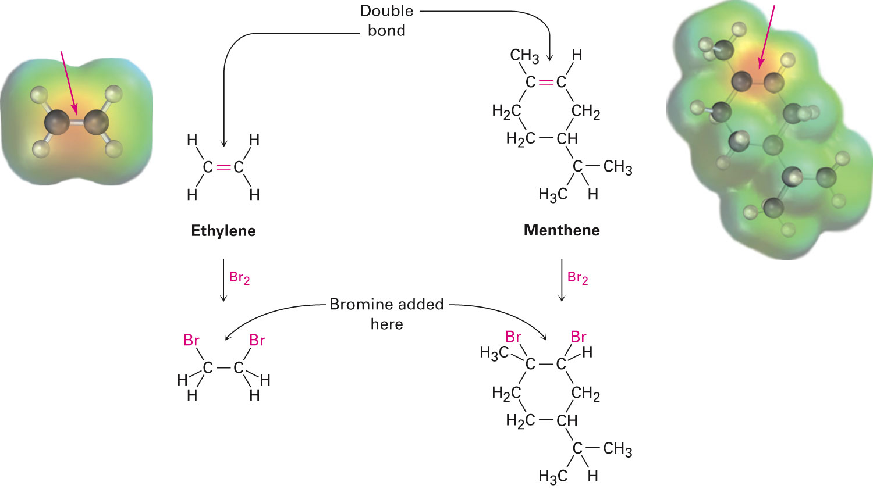
Figure 3.1 - The Reactions of Ethylene and Menthene With Bromine
Notes:
Functional groups

Slide 6
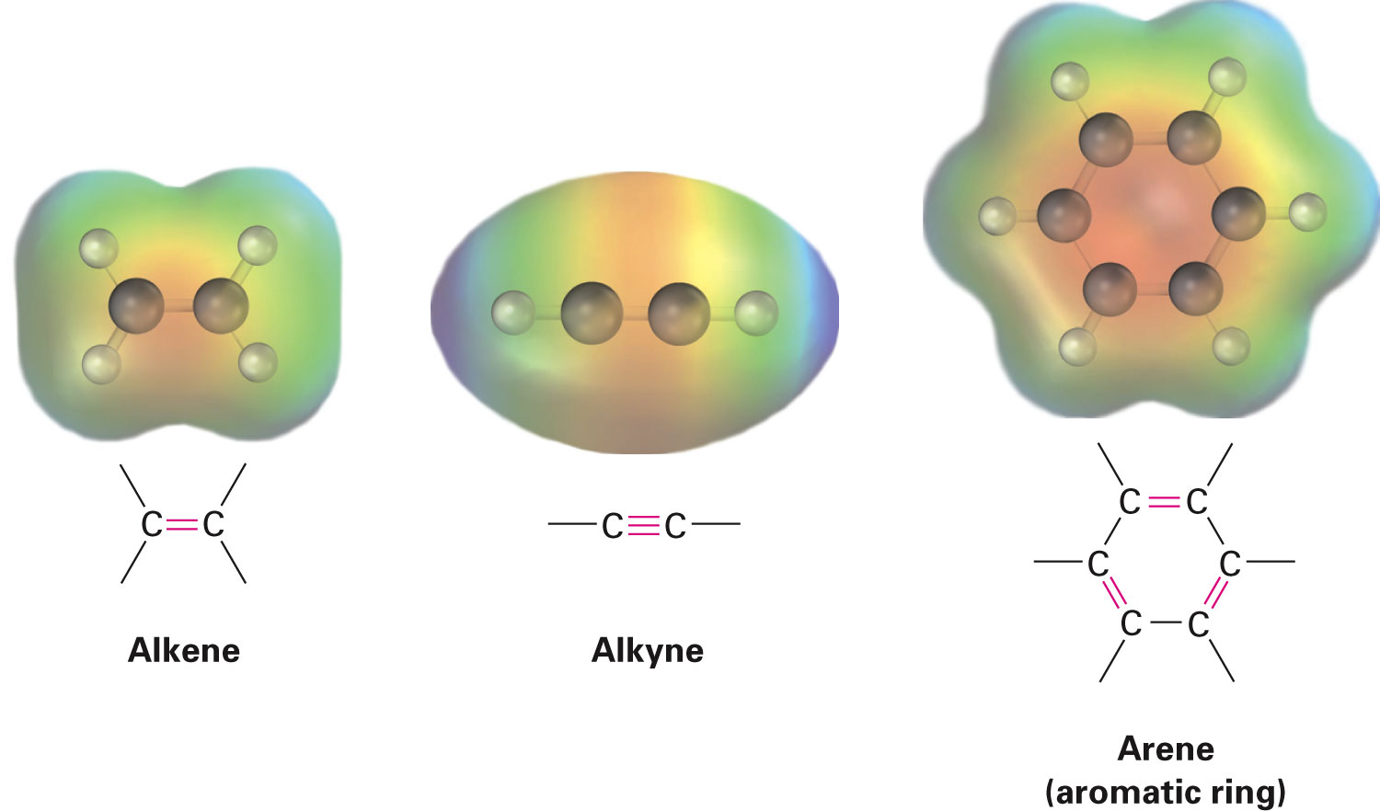
Functional Groups with Multiple Carbon–Carbon Bonds
Alkenes have a double bond
Alkynes have a triple bond
Arenes have alternating double and single C–C bonds in a six-membered ring
Notes:
Functional groups

Slide 7
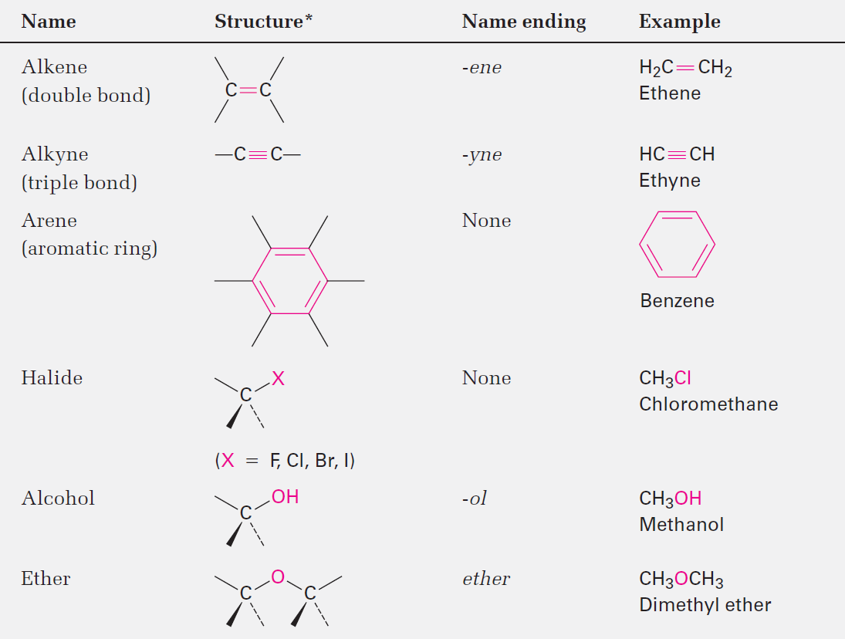
Table 3.1 - Structures of some Common Functional Groups
Notes:
Functional groups

Slide 8
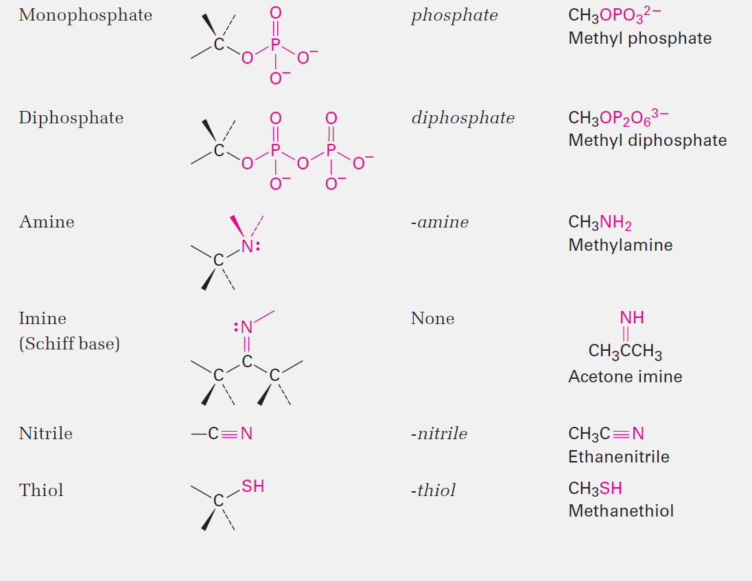
Table 3.1 - Structures of some Common Functional Groups
Notes:
Functional groups

Slide 9
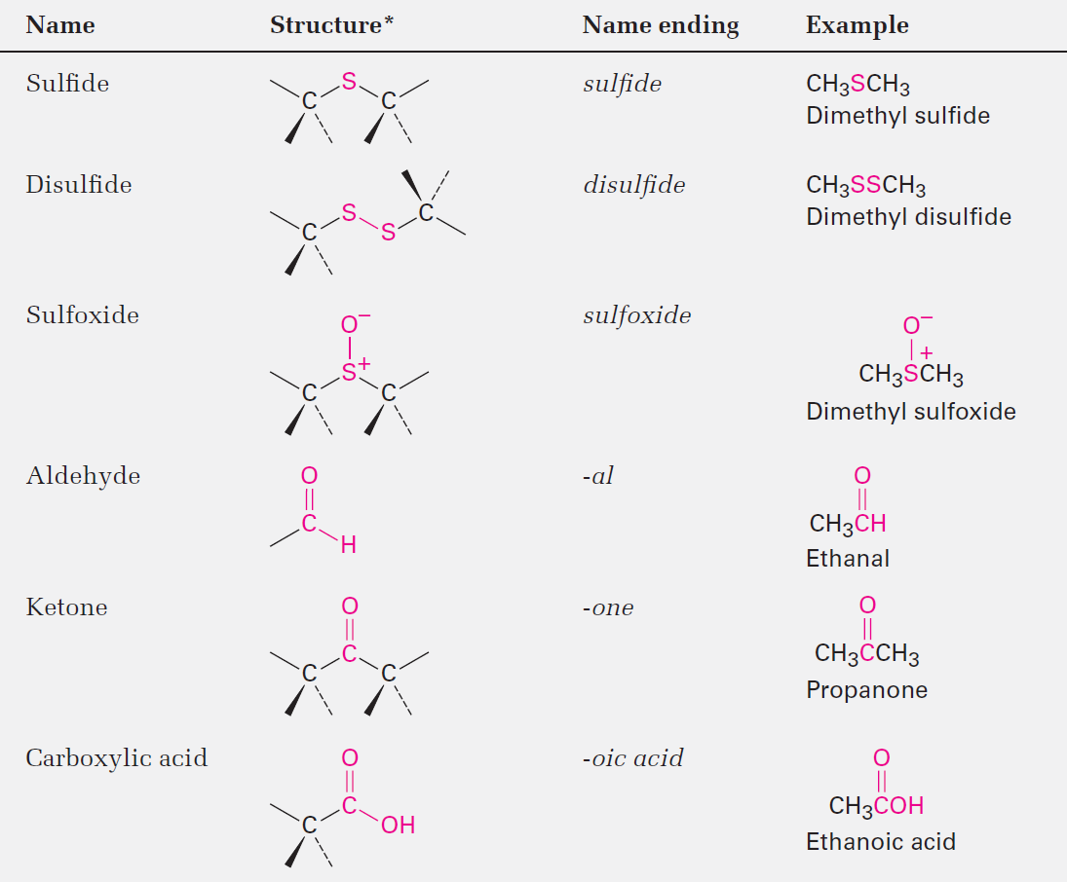
Table 3.1 - Structures of some Common Functional Groups
Notes:
Functional groups

Slide 10
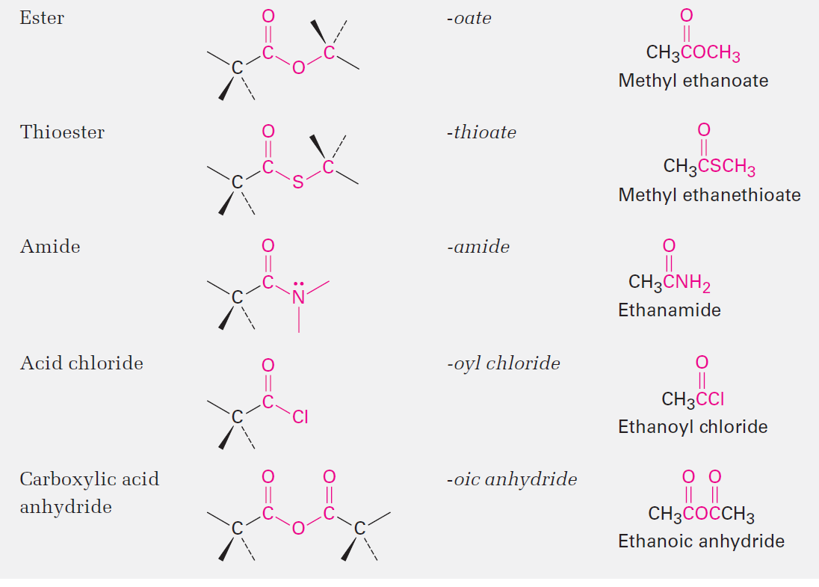
Table 3.1 - Structures of some Common Functional Groups
Notes:
Functional groups

Slide 11
Functional Groups with Carbon Singly Bonded to an Electronegative Atom
Alkyl halides (haloalkanes), alcohols, ethers, alkyl phosphates, amines, thiols, sulfides, and disulfides have a carbon singly bonded to a electronegative atom
The bonds are polar
Notes:
Functional groups

Slide 12
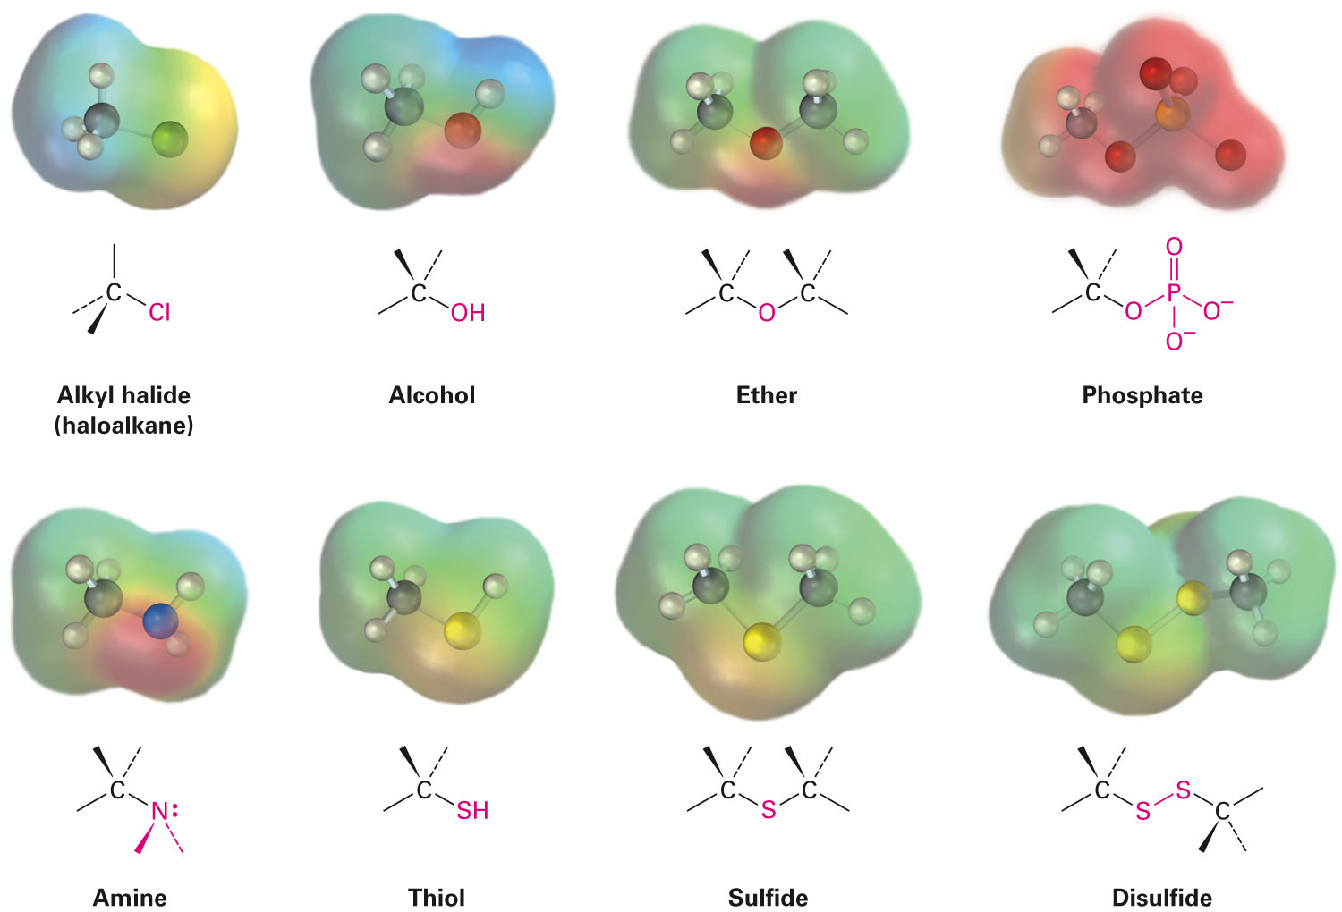
Functional Groups with Carbon Singly Bonded to an Electronegative Atom
Notes:
Functional groups

Slide 13
Functional Groups with a Carbon– Oxygen Double Bond (Carbonyl Groups)
Carbonyl groups are present in a large majority of organic compounds and biological molecules
Behave similarly in many aspects
Differ depending on the identity of the atoms bonded to the carbonyl-group carbon
Notes:
Functional groups

Slide 14
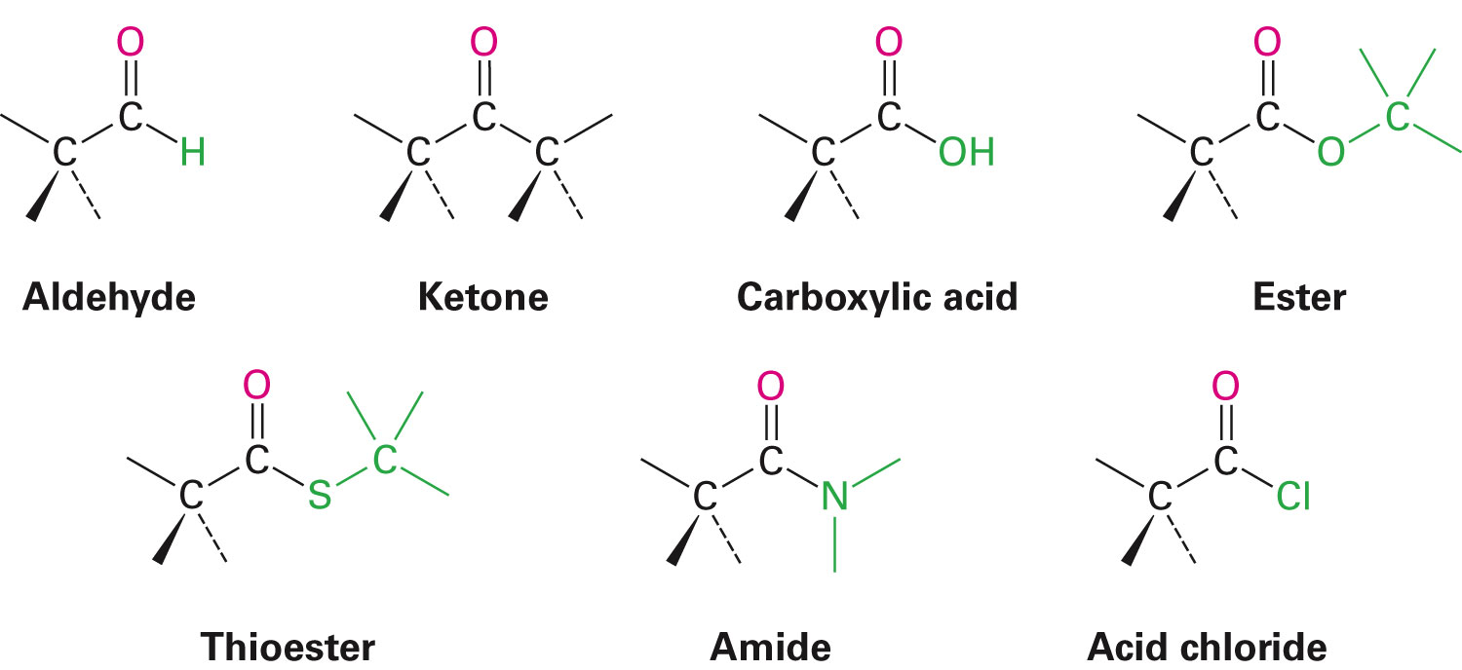
Functional Groups with a Carbon-Oxygen Double Bond (Carbonyl Groups)
Notes:
Functional groups

Slide 15
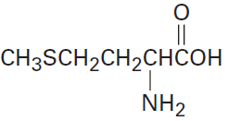
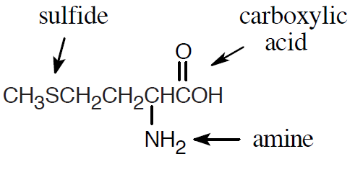
Worked Example
Identify the functional groups the molecules of methionine
Solution:
Notes:
Functional groups

Slide 16
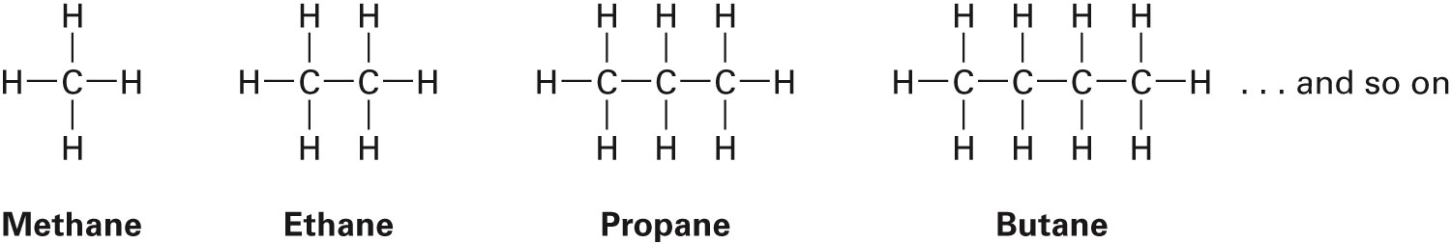
Alkanes and Alkane Isomers
Alkanes: Compounds with C–C single bonds and C–H bonds
Connecting carbons can lead to large or small molecules
Described as saturated hydrocarbons
At times called aliphatic compounds
Notes:
Alkanes and alkane isomers

Slide 17
Alkanes and Alkane Isomers
Formula for an alkane with no rings in it must be C_{n}H_{2n+2}
Where the number of C’s is n
Alkanes are saturated with hydrogen
Notes:
Alkanes and alkane isomers

Slide 18
Alkane Isomers
CH₄ = methane, C₂H₆ = ethane, C₃H₈ = propane
Molecular formula of an alkane with more than three carbons can give more than one structure
C4 (butane) = butane and isobutane
C5 (pentane) = pentane, 2-methylbutane, and 2,2-dimethylpropane
Notes:
Alkanes and alkane isomers

Slide 19
Alkane Isomers
Straight-chain alkanes: Alkanes with C’s connected to no more than 2 other C’s
Also called normal alkanes
Branched-chain alkanes: Alkanes with one or more carbon atoms connected to 3 or 4 carbon atoms
Isomers: Compounds that have the same number and kind of atoms but differ in the way the atoms are arranged
Notes:
Alkanes and alkane isomers

Slide 20
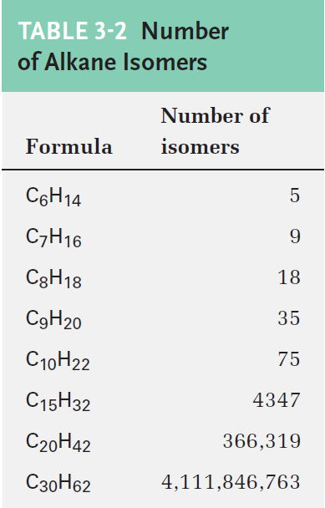
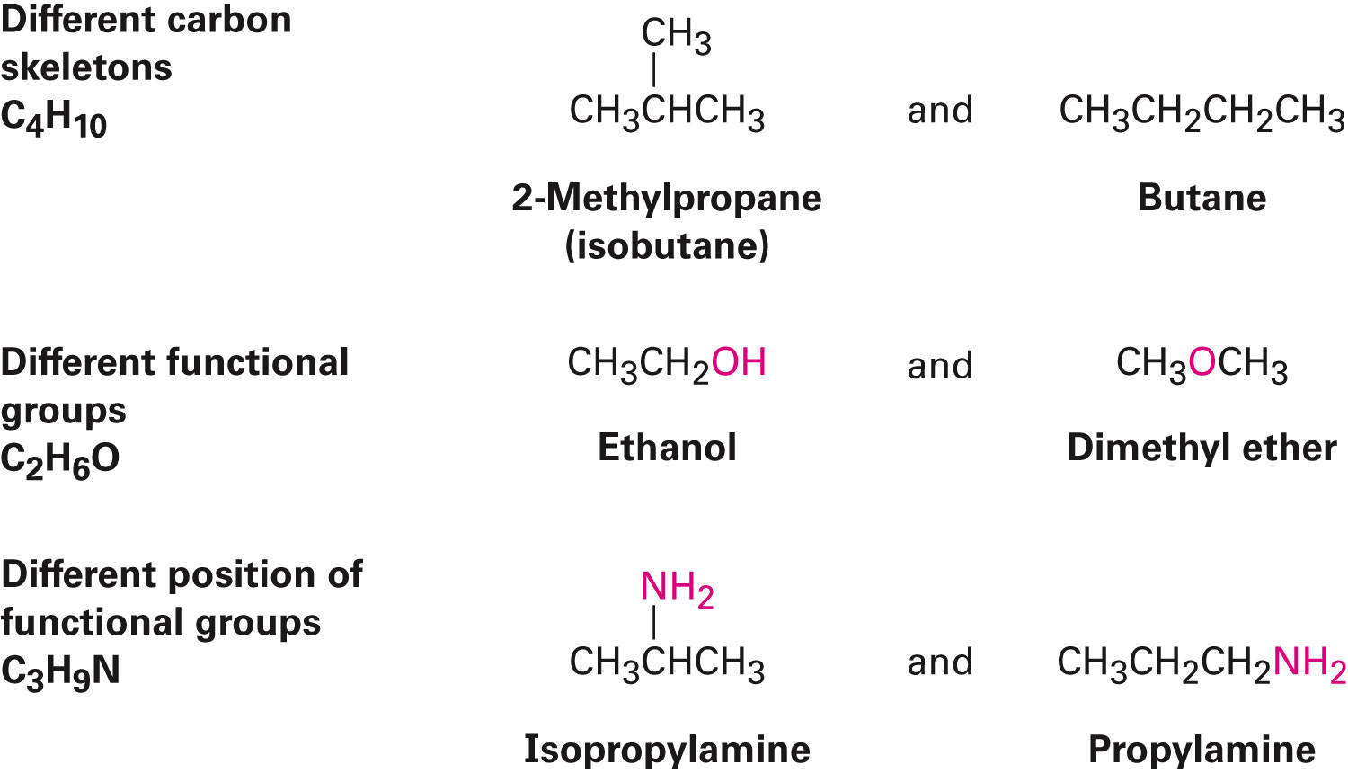
Constitutional Isomers
Isomers that differ in how their atoms are arranged in chains
Compounds other than alkanes can be constitutional isomers of one another
Notes:
Alkanes and alkane isomers

Slide 21
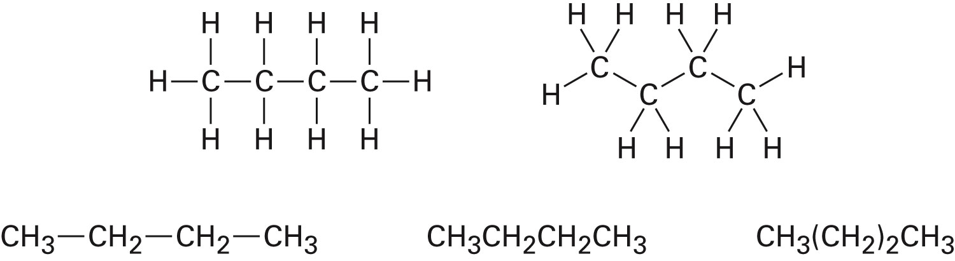
Condensed Structure of Alkanes
Represent an alkane in a brief form or in many types of extended forms
Condensed structure does not show bonds but lists atoms, such as:
CH₃CH₂CH₂CH₃ (butane)
CH₃(CH₂)₂CH₃ (butane)
Notes:
Alkanes and alkane isomers

Slide 22
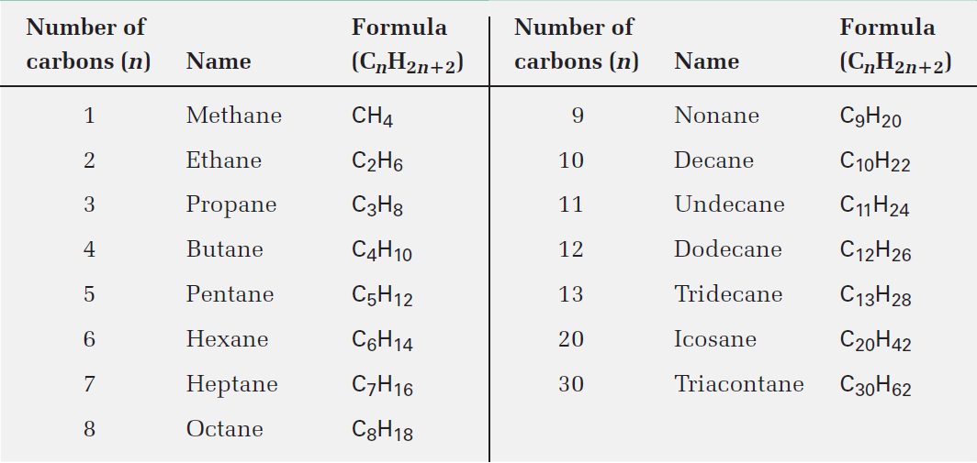
Table 3.3 - Names of Straight Chain Alkanes
Notes:
Alkanes and alkane isomers

Slide 23
Worked Example
Draw structures of the five isomers of C₆H₁₄
Solution:
Drawing all possible six-carbon skeletons and adding hydrogens to ensure that all carbons have four bonds
The six-carbon straight-chain skeleton is drawn
Drawing a five-carbon chain, identifying different types of carbon atoms on the chain, and adding a –CH₃ group to each of the different types of carbons, generating two skeletons
Notes:
Alkanes and alkane isomers

Slide 24
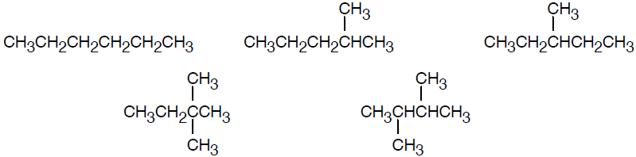
Worked Example
Repeating the process with the four-carbon chain to gives rise to the last two skeletons
Notes:
Alkanes and alkane isomers

Slide 25
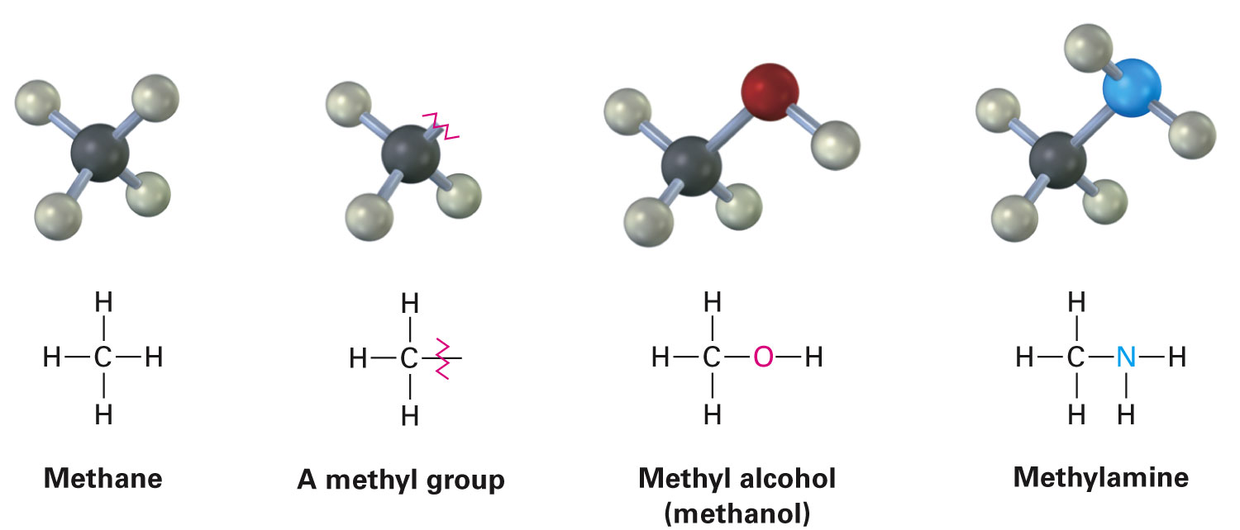
Alkyl Groups
Partial structure that remains after the removal of one H from an alkane
Not stable compounds, parts of larger compounds
Named by replacing –ane ending of alkane with –yl ending
–CH is methyl from methane (CH₄)
–CH₂CH₃ is ethyl from ethane (CH₃CH₃)
Notes:
Alkyl groups

Slide 26
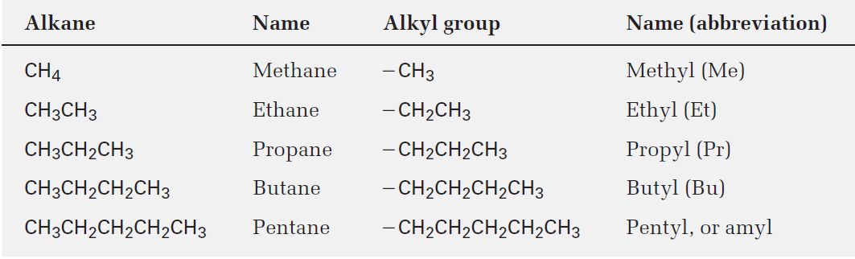
Table 3.4 - Some Straight-Chain Alkyl Groups
Notes:
Alkyl groups

Slide 27
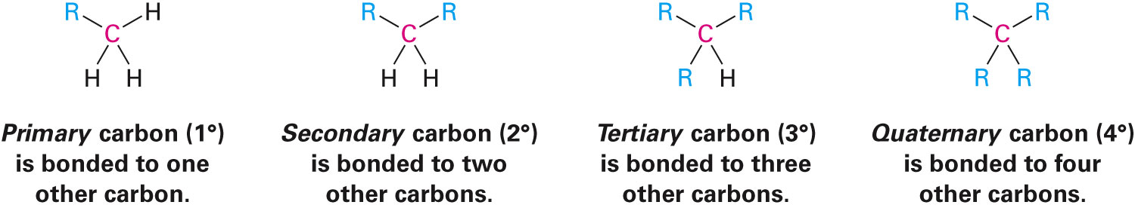
Alkyl Groups
Prefixes are used to represent the number of other carbon atoms attached to the branching carbon atom
Symbol R is used in organic chemistry to represent a generalized organic group
Notes:
Alkyl groups

Slide 28
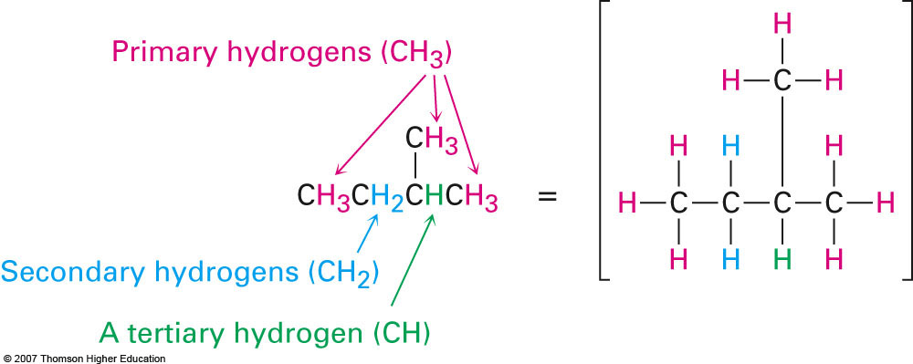
Alkyl Groups
Notes:
Alkyl groups

Slide 29
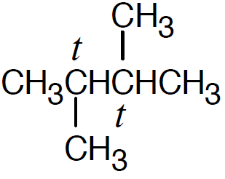
Worked Example
Draw structures of alkanes that meet the following descriptions:
An alkane with two tertiary carbons
An alkane that contains an isopropyl group
An alkane that has one quaternary and one secondary carbon
Solution:
An alkane with two tertiary carbons
Notes:
Alkyl groups

Slide 30
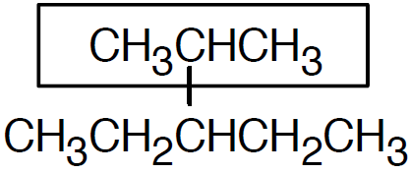
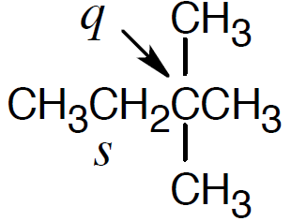
Worked Example
An alkane that contains an isopropyl group
An alkane that has one quaternary and one secondary carbon
Notes:
Alkyl groups

Slide 31
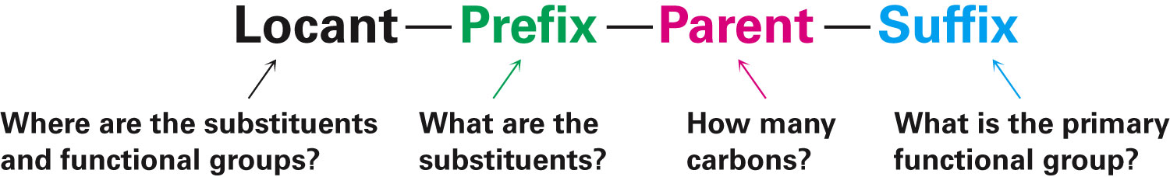
Naming Alkanes
International Union of Pure and Applied Chemistry (IUPAC) system of nomenclature
Steps in naming in complex branched-chain alkanes
Find parent hydrocarbon chain
Identify the longest continuous chain of carbon atoms, use the name of that chain as the parent name
Notes:
Naming alkanes

Slide 32
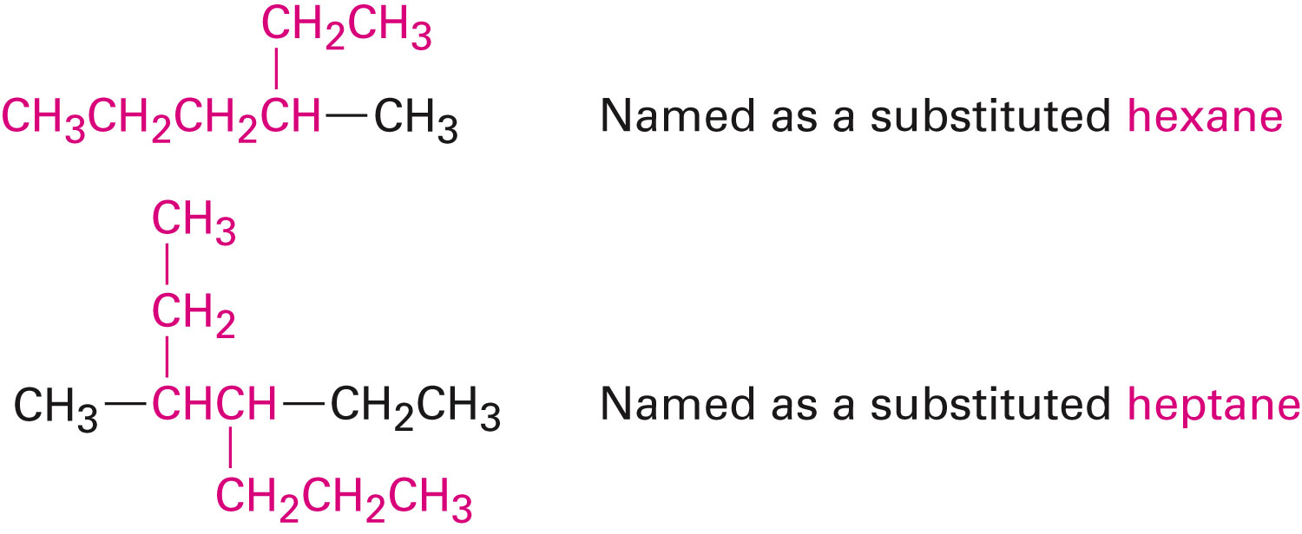
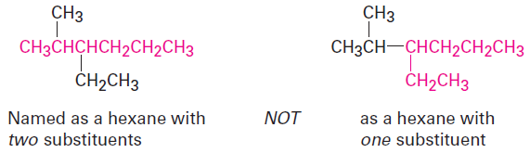
Naming Alkanes
If two different chains of equal length are present, choose the one with the larger number of branch points as the parent
Notes:
Naming alkanes

Slide 33
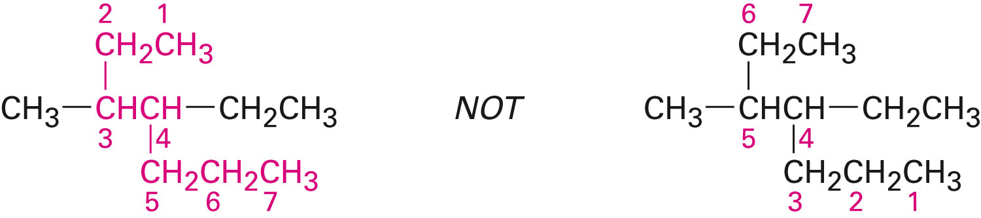
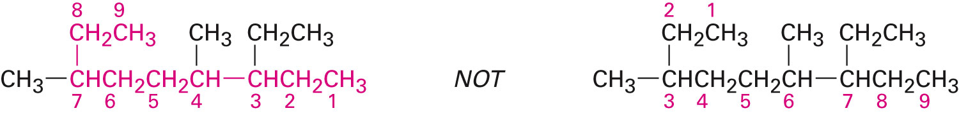
Naming Alkanes
Number the atoms in the longest chain
Beginning at the end nearer the first branch point, number each carbon atom in the parent chain
If there is branching at an equal distance away from both ends of the parent chain, begin numbering at the end nearer to the second branch point
Notes:
Naming alkanes

Slide 34
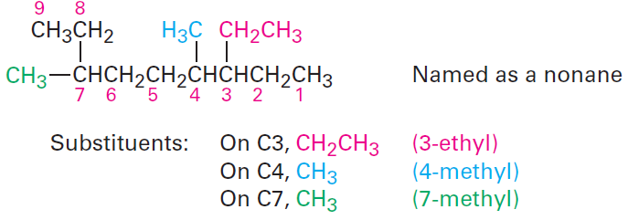
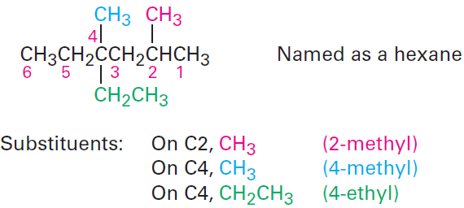
Naming Alkanes
Identify and number substituents
Assign a number, or locant, to each substituent to locate its point of attachment to the parent chain
If there are two substituents on the same carbon, give both the same number
Notes:
Naming alkanes

Slide 35
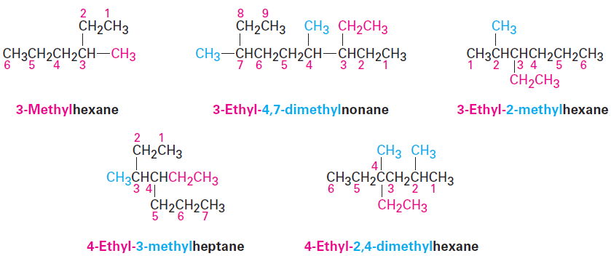
Naming Alkanes
Write the name as a single word
Notes:
Naming alkanes

Slide 36
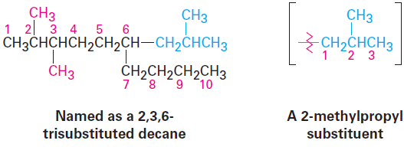
Naming Alkanes
Name a branched substituent as though it were itself a compound
Notes:
Naming alkanes

Slide 37
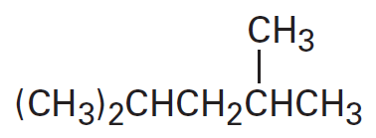
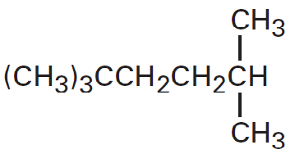
Worked Example
Give IUPAC names for the following compounds:
a)
b)
Solution:
a) 2,4-Dimethylpentane
b) 2,2,5-Trimethylhexane
Notes:
Naming alkanes

Slide 38
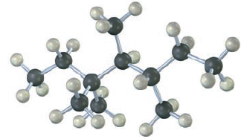
Worked Example
Give the IUPAC name for the following hydrocarbon and convert the drawing into a skeletal structure
Notes:
Naming alkanes

Slide 39
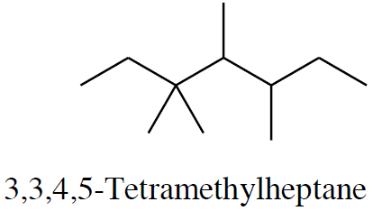
Worked Example
Solution:
Notes:
Naming alkanes

Slide 40
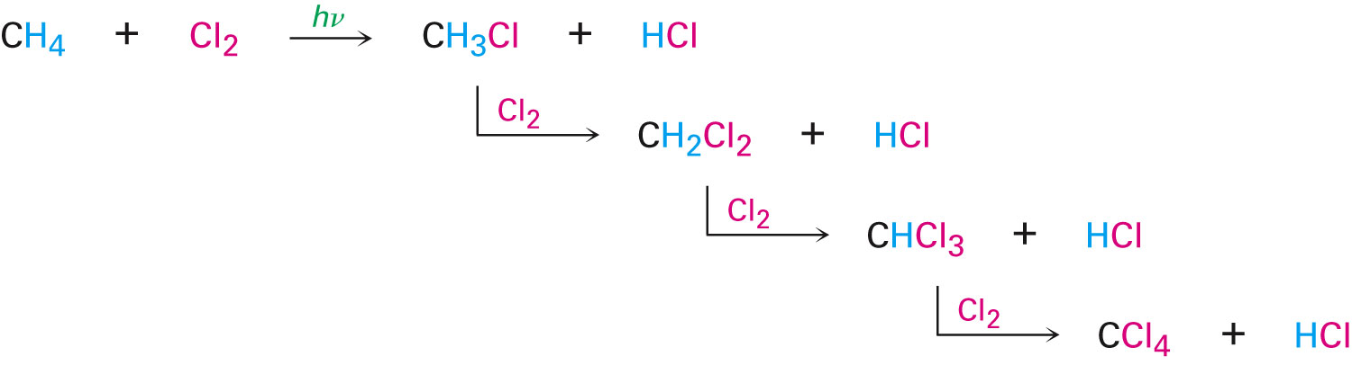
Properties of Alkanes
Called paraffins because they do not react as most chemicals
Low affinity compounds
Burn in a flame, producing carbon dioxide, water, and heat
Methane reacts with Cl₂ in the presence of light to produce:
Notes:
Properties of alkanes

Slide 41
Physical Properties of Alkanes
Boiling points and melting points increase as size of alkane increases
Dispersion forces increase as molecule size increases, resulting in higher melting and boiling points
Notes:
Properties of alkanes

Slide 42
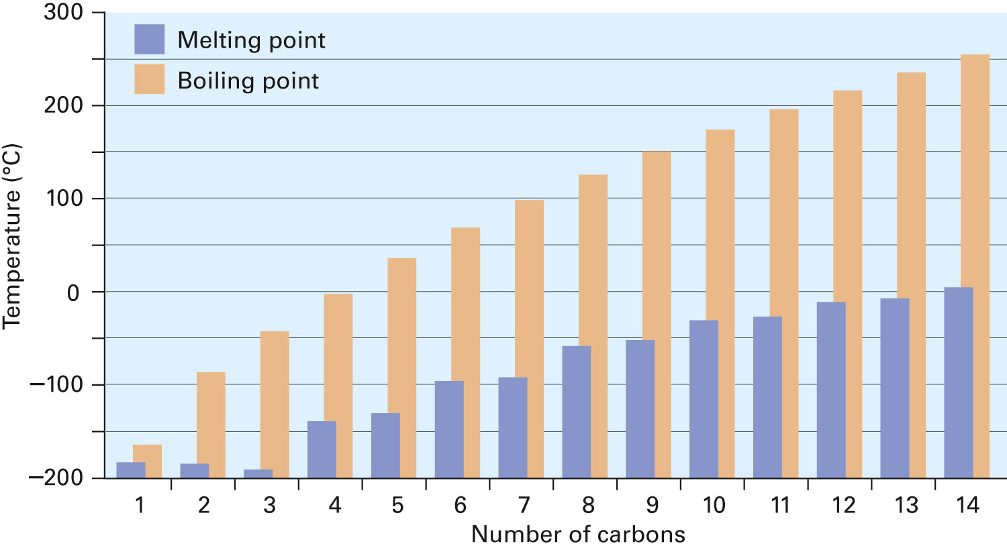
Figure 3.4 - A Plot of Melting and Boiling Points Versus Number of Carbon Atoms for the C₁–C₁₄
Notes:
Properties of alkanes

Slide 43
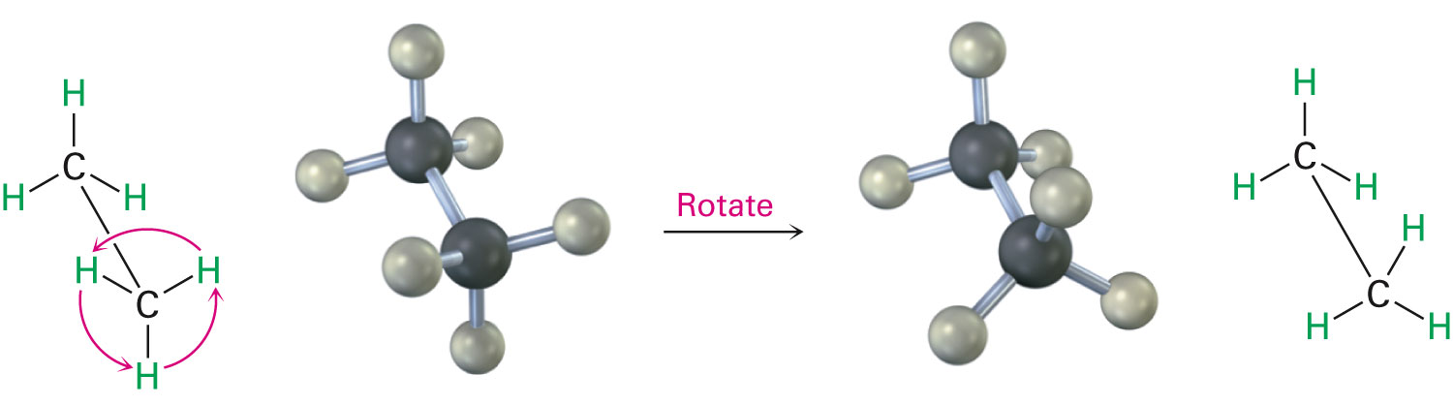
Conformations
Stereochemistry: Branch of chemistry concerned with the 3 dimensional aspects of molecules
σ bonds are cylindrically symmetrical
Rotation is possible around C–C bonds in open-chain molecules
Notes:
Conformations of ethane

Slide 44
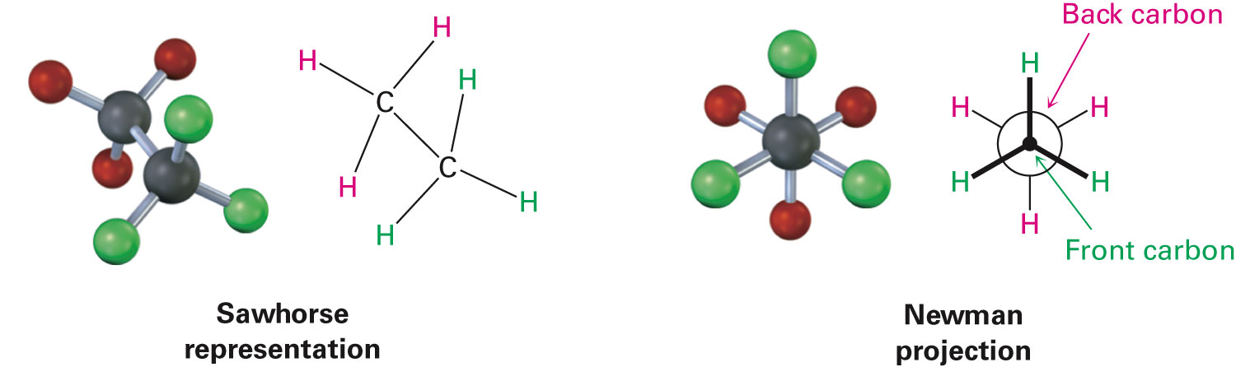
Conformations
Different arrangement of atoms resulting from bond rotation
Conformers: Molecules that have different arrangements
Called conformational isomers
Can be represented in 2 ways
Notes:
Conformations of ethane

Slide 45
Torsional Strain
Strain in a molecule caused by electron repulsion between eclipsed bonds
Perfectly free rotation is not observed
There is a barrier to rotation, and some conformers are more stable than others
Staggered conformation: Most stable
All 6 C–H bonds are as far away as possible
Eclipsed conformation: Least stable
All 6 C–H bonds are as close as possible to each other
Notes:
Conformations of ethane

Slide 46
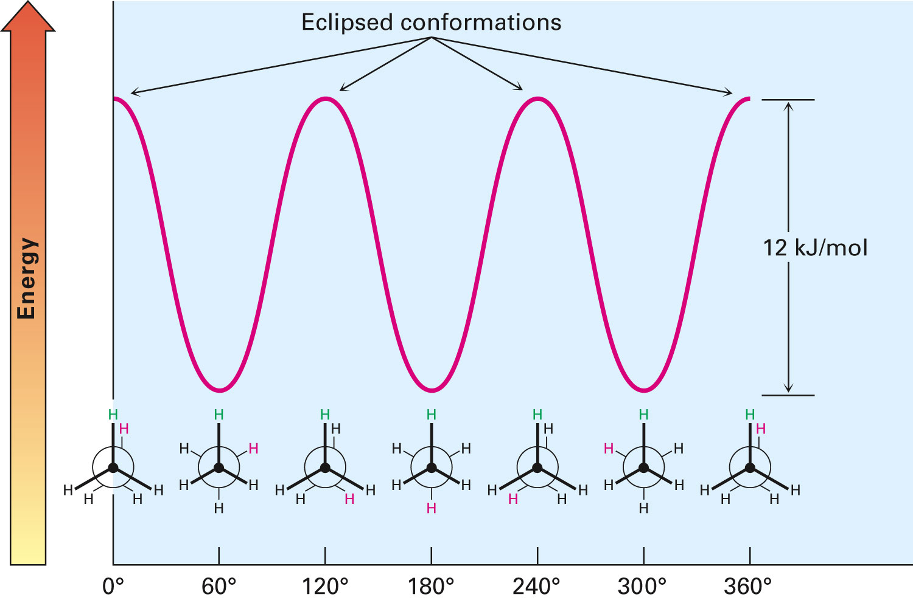
Figure 3.7 - A Graph of Potential Energy Versus Bond Rotation in Ethane
Notes:
Conformations of ethane

Slide 47
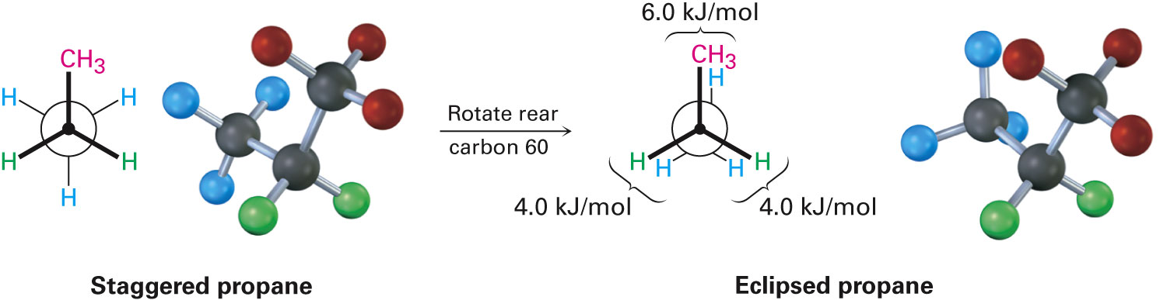
Conformations of Other Alkanes
Eclipsed conformer of propane has 3 interactions - Two ethane-type H–H interactions, and one H–CH₃ interaction
Notes:
Conformations of other alkanes

Slide 48
Conformations of Other Alkanes
Conformational situation is more complex for larger alkanes
Not all staggered conformations have same energy
Not all eclipsed conformations have same energy
Anti conformation: Geometric arrangement around a C–C single bond in which the two largest substituents are 180°apart
As viewed in a Newman projection
Notes:
Conformations of other alkanes

Slide 49
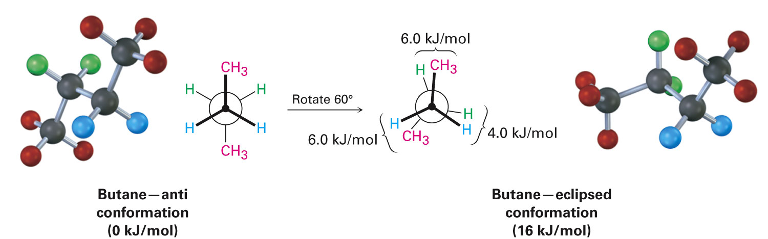
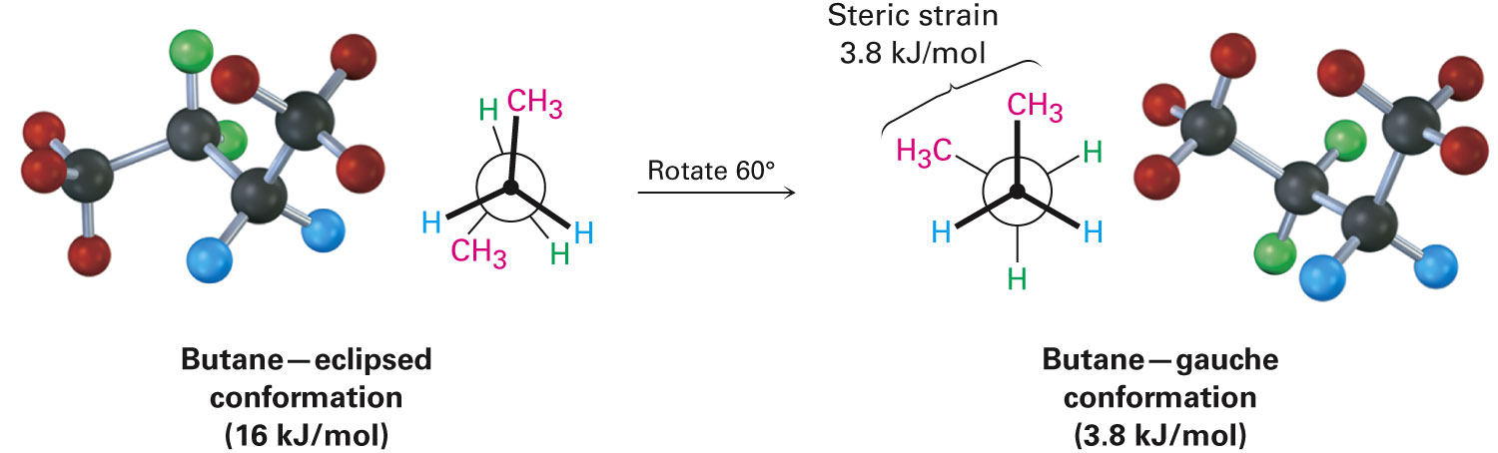
Conformations of Butane
Gauche conformation: Conformation of butane in which the two methyl groups lie 60°apart
Notes:
Conformations of other alkanes

Slide 50
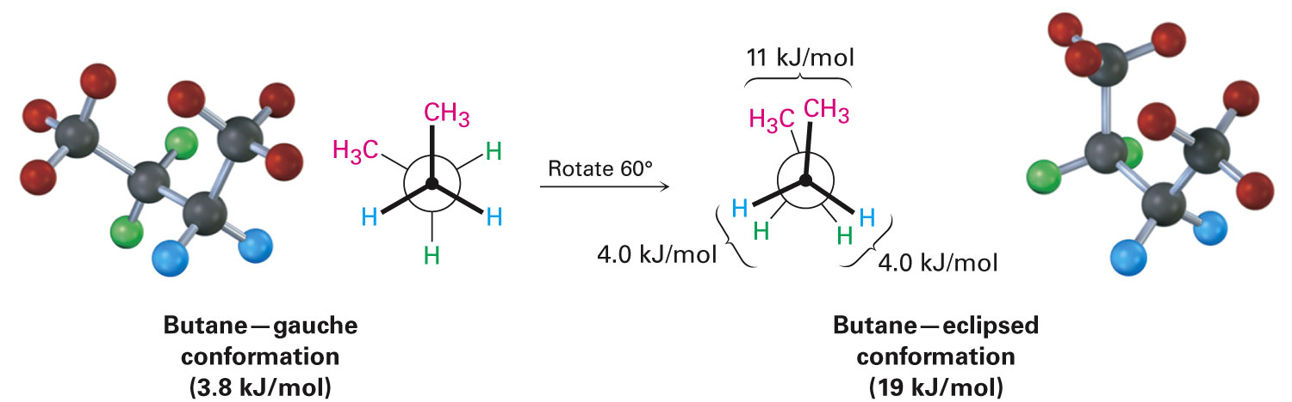
Steric Strain
Repulsive interaction that occurs when atoms are forced closer together than their atomic radii allow
Notes:
Conformations of other alkanes

Slide 51
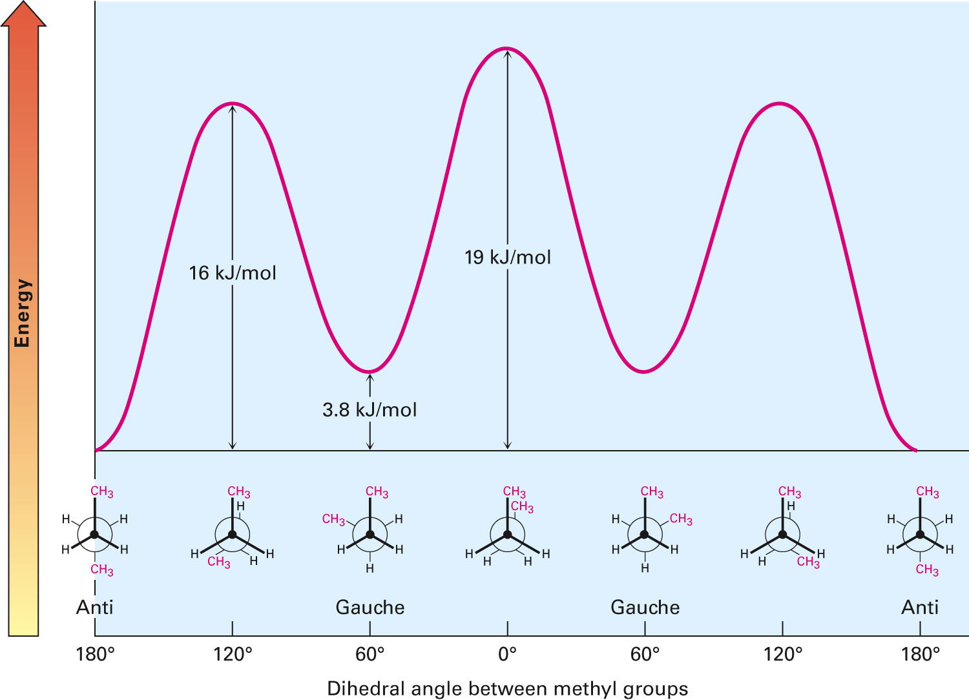
Figure 3.9 - A Plot of Potential Energy Versus Rotation for the C2–C3 Bond in Butane
Notes:
Conformations of other alkanes

Slide 52
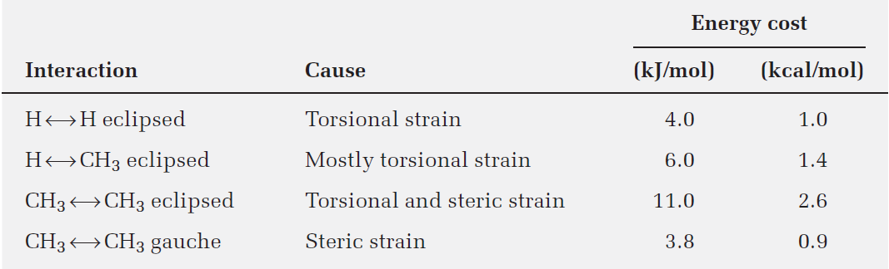
Table 3.5 - Energy Costs for Interactions in Alkane Conformers
Notes:
Conformations of other alkanes

Slide 53
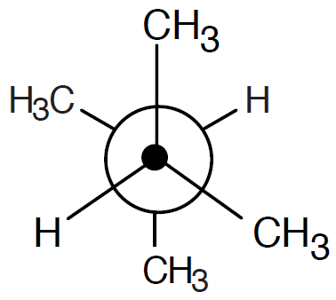
Worked Example
Sight along the C2–C3 bond of
2,3-dimethylbutane
Draw a Newman projection of the most stable conformation
Solution:
This conformation of 2,3-dimethylbutane is the most stable because it is staggered
Has the fewest CH3↔CH3 gauche interactions
Notes:
Conformations of other alkanes

Slide 54
Summary
Group of atoms within a larger molecule that has a characteristic chemical reactivity is called a functional group
Chemical reactions of an organic molecule are determined by its functional groups
Alkanes are a class of saturated hydrocarbons
Alkanes don’t contain functional groups, are relatively inert, and can be either straight-chain or branched

Slide 55
Summary
Constitutional isomers are compounds that have the same chemical formula but different structures which differ in their connections between atoms
Rotation is possible around σ bonds because of their cylindrical symmetry
Alkanes exist in a large number of rapidly interconverting conformations
Newman projections make it possible to visualize the spatial consequences of bond rotation

Slide 56
Summary
Staggered conformation of ethane is 12 kJ/mol (2.9 kcal/mol) and more stable than the eclipsed conformation because of torsional strain
Generally all alkanes are most stable when all of its bonds are staggered

